Slide 1
/
/login
MONSTERBORG COMMAND CENTER
Please login...
Username :
Password :
{{ error_message }}
username
password
submit

Slide 2
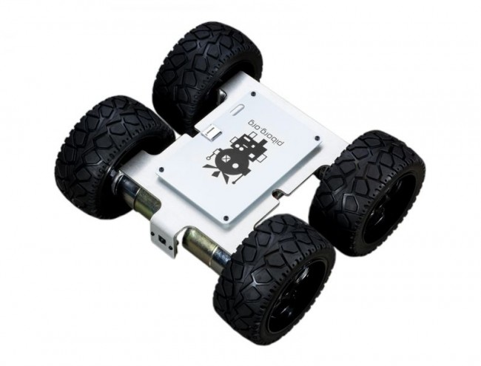
MONSTERBORG COMMAND CENTER
/home
MENU
LOGOUT
START
STOP
Batterie
Comm.
Systèmes
Statut
Batterie
Battery level
CPU usage RAM usage
Stop/Running
Round trip delay
MonsterBorg Project v1.0 - monsterborg.ppdlab.ch - march 2021

Slide 3
MONSTERBORG COMMAND CENTER
/home
MENU
LOGOUT
<form method="POST" action="startstop">
START
STOP
<img src="http://monsterborg.ppdlab.ch:8080/video_feed" width="100%">
<form method="POST" action="move">
Batterie
Comm.
Systèmes
Statut
Batterie
{{ battery }}
{{ round_trip_delay }}
{{ cpu_usage}}
{{ state }}
MonsterBorg Project v1.0 - monsterborg.ppdlab.ch - march 2021

